Slide 1
EMPLOYEE DATA PROJECT
BY
SHIVAM RAMDAS CHAUDHARI

Slide 2
ABOUT THE PROJECT :
THE PROJECT IS ALL ABOUT THE DESCRIPTIVE ANALYSIS OF EMPLOYEES DATA TAKEN FROM Kaggle.com WHICH CONTAINS 21 ROWS AND 5 COLUMNS .
THE COLUMNS CONSISTS OF MANY PARAMETERS SUCH AS EMP ID, FIRST NAME, LAST NAME, REGION, BASIC SALARY, DEPARTMENT, YEARS OF EXPERIENCE, BONUS, COMPANSATION ETC.
THIS STUDY HELP YOU TO UNDERSTAND THE PAST AND PRESENT BUSINESS SCENARIO WHICH HELPS TO MAKE THE STRATEGIES FOR THE GROWTH OF THE EMPLOYEES.

Slide 3
PROBLEM STATEMENTS :
Display the Total Basic Salary by Department
Display the Average Bonus by Region
Display the Employee Count per Department
Display the Total Compensation by Department
Display the Average Years of Experience by Region
Display Top 5 Employees by Bonus
Display the Average Basic Salary by Years of Experience
Display the Total Bonus by Region and Department
Display the Departmental Bonus Percentage
Display the Employees with Above-Average Bonus

Slide 4
Total Basic Salary by Department :

Slide 5
Average Bonus By Region :

Slide 6
Employee Count per Department :

Slide 7
Total Compensation By Department :

Slide 8
Average Years of Experience by Region :

Slide 9
Employee By Bonus :

Slide 10
Average Basic Salary By Years Of Experience :

Slide 11
Total Bonus By Region and Department :

Slide 12
Department Wise Bonus Percentage :

Slide 13
Employee with Above-Average Bonus :

Slide 14
Dash Board:

Slide 15
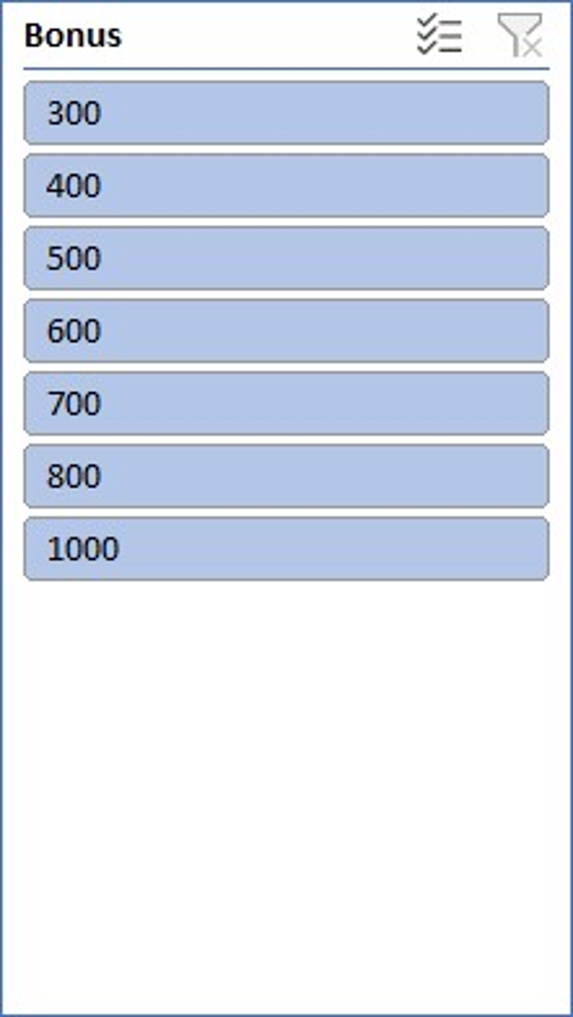
Dash Boards :

Slide 16
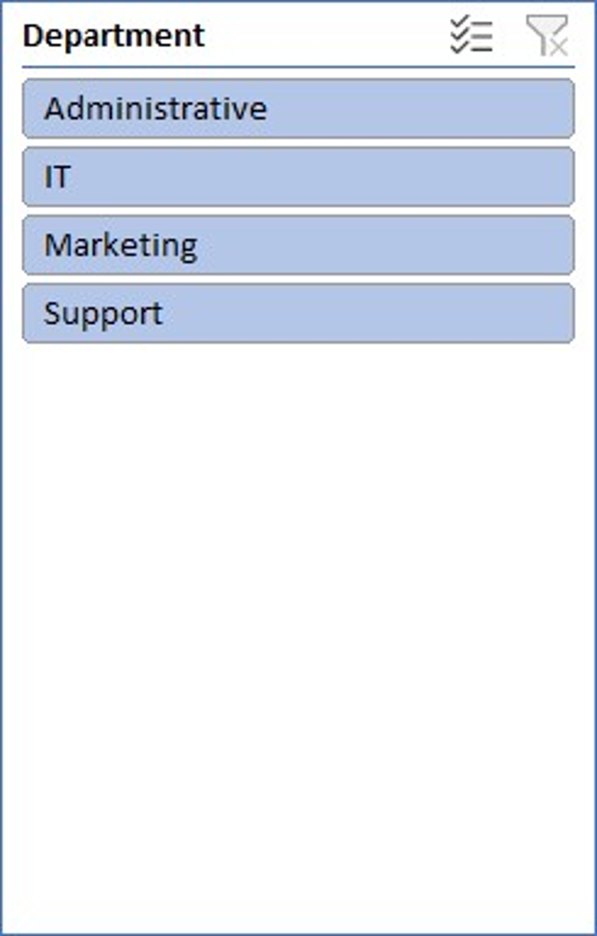
Dash Board:

Slide 17
CONCLUSION :
1.Departmental Compensation Trends:
IT Department: Exhibits the highest compensation figures, with salaries ranging from ₹15,000 to ₹55,000 and bonuses between ₹300 and ₹1,000. This suggests a significant investment in technical roles.
Administrative Roles: Show consistent compensation, averaging around ₹25,000 with bonuses typically at ₹800, indicating standardized pay structures.
Support Staff: Receive lower compensation, with salaries between ₹5,000 and ₹13,000 and bonuses from ₹300 to ₹600, highlighting potential areas for review.
2.Experience vs. Compensation:
A positive correlation exists between years of experience and total compensation. For instance, an IT employee with 9 years of experience earns ₹56,000, while those with 1–3 years earn between ₹15,000 and ₹21,000.
3.Regional Disparities:
Employees in the East and West regions tend to have higher compensation packages compared to those in the South and North, suggesting regional pay differences that may need addressing.

Slide 18
Next Steps:
1.Data Validation and Cleaning:
Ensure each employee has a unique identifier to maintain data integrity.
Standardize data entries to eliminate inconsistencies and duplicates.
2.Conduct a Comprehensive Compensation Analysis:
Utilize tools like Excel or specialized compensation analysis software to assess pay structures across departments and regions.
Identify and address any pay disparities or inequities.linkedin.com+8wellhub.com+8aihr.com+8
3.Benchmark Against Industry Standards:
Compare your organization's compensation packages with industry and regional benchmarks to ensure competitiveness.

Slide 19
Next Steps :
4.Develop a Transparent Compensation Strategy:
Establish clear guidelines for salary ranges, bonuses, and incentives based on roles, experience, and performance.
Communicate this strategy organization-wide to promote transparency and trust.
5.Implement Regular Reviews:
Schedule periodic compensation reviews to adapt to market changes and internal growth.
Engage stakeholders from HR, finance, and department heads in these reviews for comprehensive insights.

Slide 20
Project Link :
Excel :
Shivam4560/Employee-Data
ViDeo PRESENTATION:

Slide 21
THANK YOU …

